Slide 1
MACHINE
LEARNING ClimateWins
Michael Higgins | January 2024

Slide 2
TABLE OF CONTENTS
01
02
03
04
05
OBJECTIVE
DATA
HYPOTHESE
06
OPTIMISATION
ALGORITHMS
SUMMARY

Slide 3
01
OBJECTIVE

Slide 4
ClimateWins
To understand the potential effectiveness of applying machine learning to climate data to predict the consequences of climate change.

Slide 5
02
DATA

Slide 6
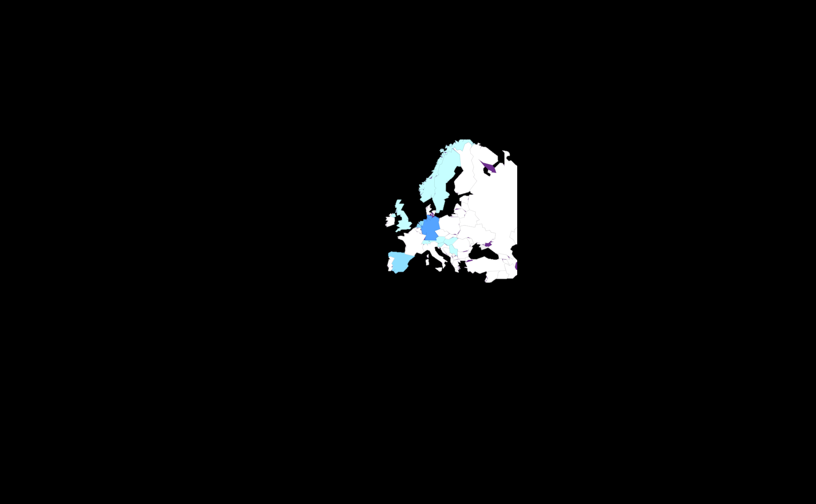
WEATHER STATIONS
ONE
TWO
THREE
Data has been collected by the European Climate Assessment and Dataset project and has daily data from 1960 to 2022 for 15 European locations.
The following data characteristics are collected in each location:
Cloud cover
Wind speed
Humidity
Pressure
Global radiation
Precipitation
Snow depth
Sunshine
Temperature (minimum, mean, and maximum)

Slide 7
POTENTIAL BIAS
LOCATION
ACCURACY
The 15 locations for data collection are all European, and mainly central. Any results cannot be determined to fully represent continental or global changes.
Measurement accuracy has improved in the period covered by the data. Potential errors are greater with the historic values due to limitations from instrumentaiton.
HISTORIC
ENVIRONMENT
The data set was first compiled in 1998 using historic data, and has been updated since. There is evidence of imputation where results were missing.
Measurement locations include city centres, which are affected by the Urban Heat Island effect. Therfore some locations will have a greater human impact on temperatures measured.

Slide 8
03
HYPOTHESE

Slide 9
POTENTIAL HYPOTHESE
AVERAGE TEMPERATURE
EXTREME WEATHER
RADIATION LEVELS
If the average temperature in one location increases over time then the other locations will increase proportionally.
If the average temperature increases then the frequency of other metrics showing extreme results will increase.
If the maximum temperature increases then the radiation level will increase proportionally.

Slide 10

04
OPTIMISATION

Slide 11
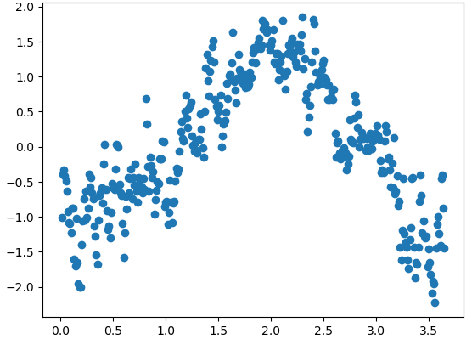
GRADIENT DECENT
ROME 1977
Each iteration the function determines the gradient in several directions from the current position and looks to move towards the maxima or minima.
If the gradient it either positive or negative in all directions a maxima/minima has been found.
Temperature (scaled)
Day

Slide 12
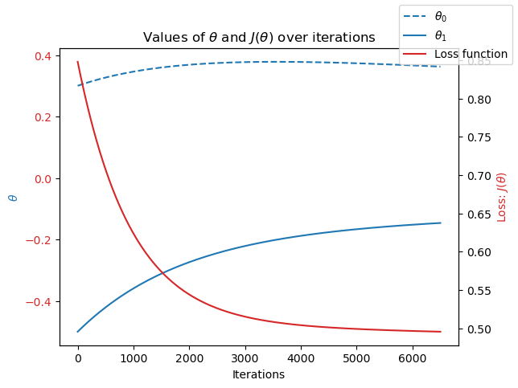
GRADIENT DECENT
Due to the noise in data the gradient decent function will often find local optimum, rather than the global optimum.
When the loss function, J(θ)=0, the function has found a global maximum.
The graph shows that the global optimum is approached after (approx.) 500 iterations, but it has overshot, and the function continues to iterate.
Around 4000 the graph is converging on a local optimum with a loss of 0.50.

Slide 13
05
ALGORITHMS

Slide 14
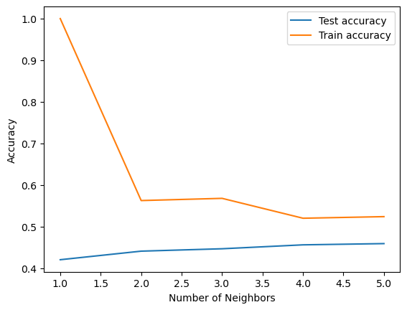
ALGORITH 01: K-NEAREST NEIGHBORS
Looks to find the k data points most like each datum in the set.
The data are then grouped into a given number of sets.
New data added are then assigned a set and predictions made based on their set and values.
For the climate data there was limited increase in accuracy as the number of neighbours increased.
Accuracy did not reach 0.5 for 5 neighbours, and the trend suggested it is unlikely to achieve even this low level of accuracy.

Slide 15
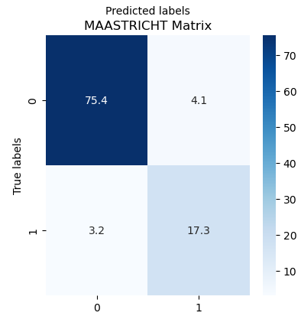
ALGORITH 02: DECISION TREE
Creates a series of Yes/No questions about the data
New data are sorted according to the questions
From this a predicted output is determined
The confusion matrix (right) for Maastrict shows that when tested 4.1% os data were incorrectly sorted as False and 3.2% incorrectly determined True when assessing them for the Pleasant Weather statistic. 88.7% of data were correctly sorted when predicting their Pleasant Weather determination.
Maastricht was one of the most accurate cities for predating weather type, with the average being 63.7% accuracy

Slide 16

ALGORITH 03: ARTIFICIAL NEURAL NETWORK
Applies weights to decisions over a given number of layers.
The network is trained for a given number of epochs
Each epoch will return different results for classification, but with aim to improve its results.
When optimised the ANN’s results for Maastricht misclassified 4.7% of results.
The overall best results for all cities showed a 71.2% accuracy using three layers of size 20 over 2000 epochs. After which the results began overfitting.

Slide 17
06
SUMMARY

Slide 18
SUMMARY
HYPOTHESIS
METHOD
If the average temperature increases then the frequency of other metrics showing extreme results will increase.
Artificial Neural Network showed the best reults for guided machine learning.
Unguided machine learning has the potential for even better results.
NEXT STEPS AND FUTURE ANALYSIS
Determine the null hypothesis and the required analysis for its support or to disprove.
Investigate unguided machine learning and assess its potential accuracy.
Test and train the chosen algorithm to a suitable dataset to determine if machine learning can use temperature to predict extreme weather.

Slide 19
QUESTIONS
MHigginsAnalytics@gmail.com
https://mdhigg.github.io/Portfolio/

